Slide 1
Computing and Global Health Lecture 7 Treatment support and mobile devices
Winter 2015
Richard Anderson

Slide 2
Today’s topics
Aditya Vashistha
Voice based messaging
Treatment Support
Adherence
Protocol Support
Diagnostics
Gadgets
Hijack
ODK Sensors
FoneAstra
Partopen
CellScope
ColdTrace

Slide 3
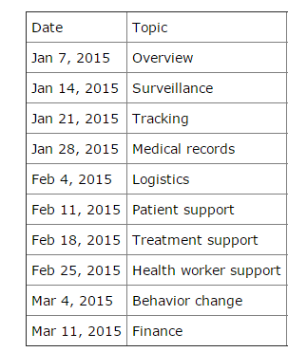
Readings and Assignments
Readings
eIMCI
CellScope
Hijack
Homework 6
Design an SMS syntax for cold chain reporting
Homework 7
Paper prototype of medical protocol
Details TBD
Homework 8
Open Data Kit

Slide 4
Homework 7: SMS Reporting

Slide 5
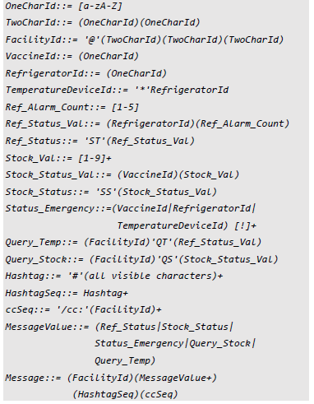
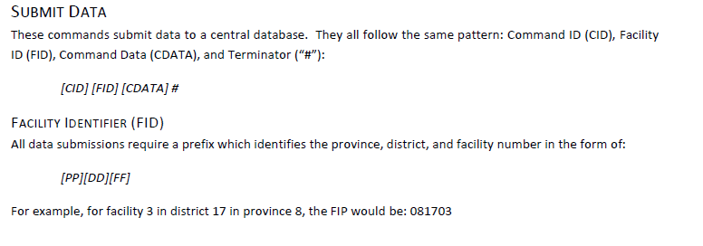
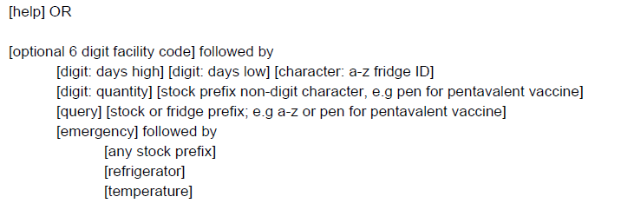
Homework 7: Solutions

Slide 6
Medication Adherence
TB and HIV
Concerns about drug resistant strains
Adherence obstacles
Side effects, inconvenience, perceived cure, stigma

Slide 7
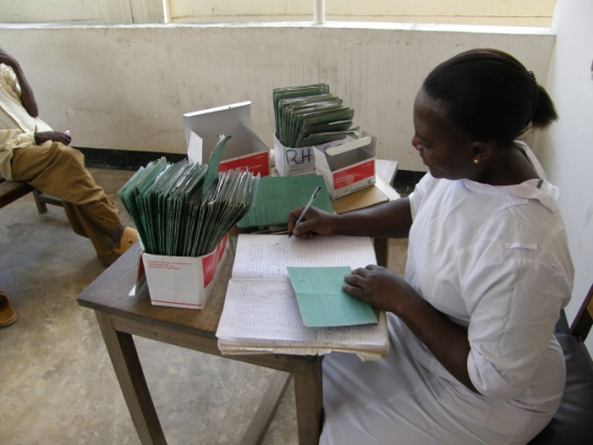
Adherence
Direct Observation Therapy
Health worker observes daily medication
Home or clinic
Considered burdensome
Variations
Family member observes
Pick up medication every few days
WHO TB Strategy
Pursue high-quality DOTS expansion and enhancement
Secure political commitment, with adequate and sustained financing
Ensure early case detection, and diagnosis through quality-assured bacteriology
Provide standardized treatment with supervision, and patient support
Ensure effective drug supply and management
Monitor and evaluate performance and impact

Slide 8
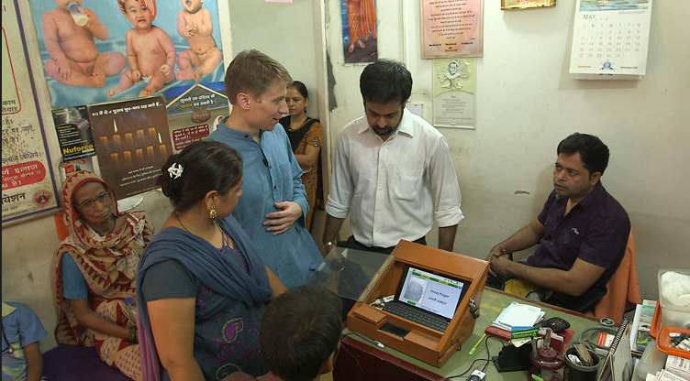
TB Drug Distribution
Fingerprint scanning in drug distribution
Reduce record keeping and increase accuracy
Verification of drug pick up
Allow follow up of non-compliant

Slide 9
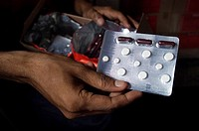
SMS Reporting
Send confirmation code associated with each pill to a given number
4387

Slide 10
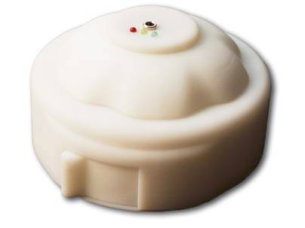
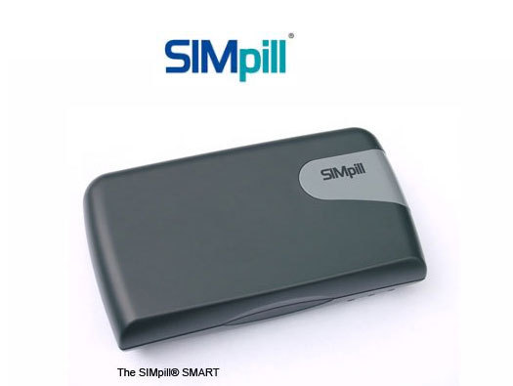
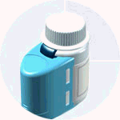
Pill box notifications
Pill box records openings
Dispense a fixed amount each day
SimPill – built in SMS modem and simcard
Automatic notifications
Initial development for low resource settings but commercialized for developed world

Slide 11
Delivery of health services
Routine care delivered by Nurses or CHWs
Problems to solve
Consistent delivery of services
Standards based
Competent
Availability
Appropriate escalation and referal

Slide 12
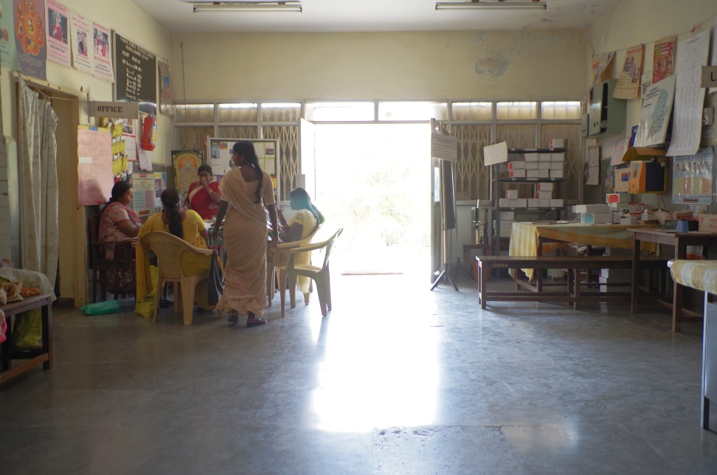
Vision versus reality

Slide 13
IMCI
WHO Designed protocol on diagnosing/treating childhood illness
Step through diseases with flow chart
Target nurses/health workers
Standardize care

Slide 14
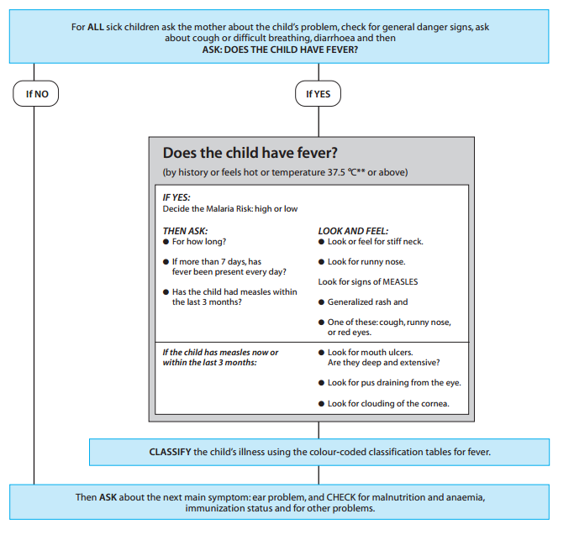
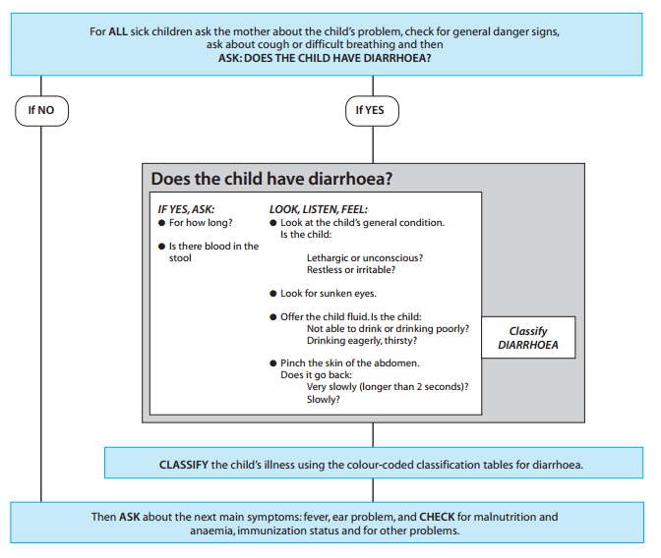
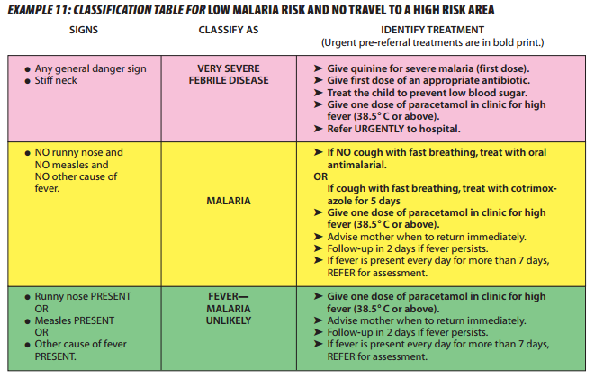
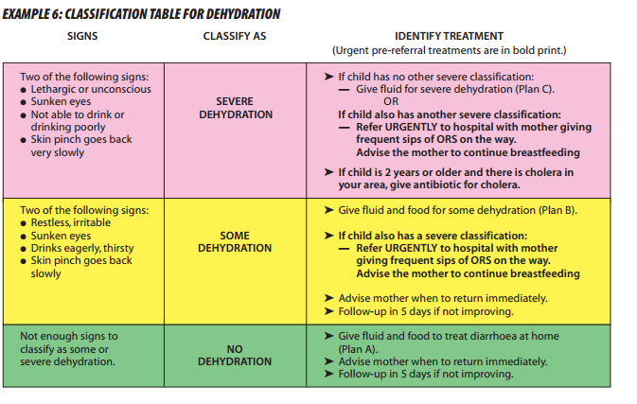
IMCI

Slide 15
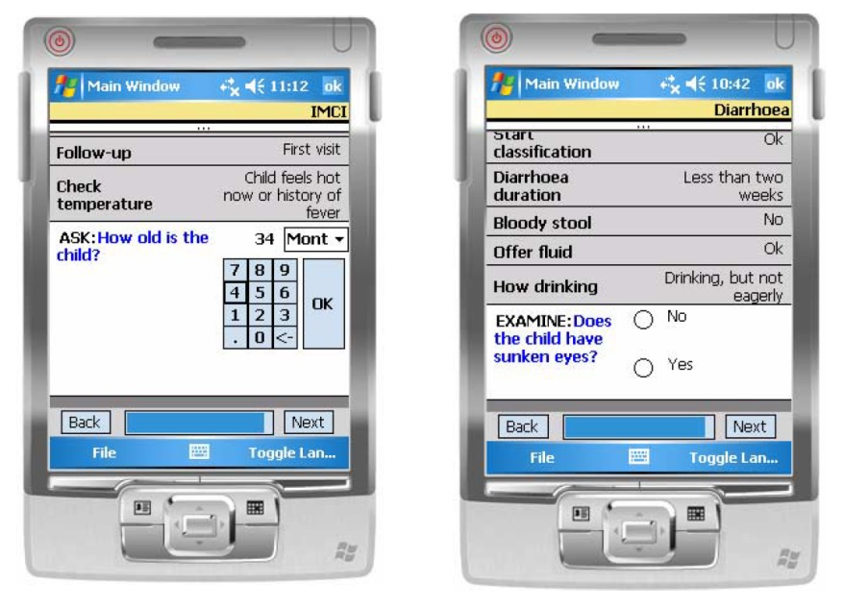
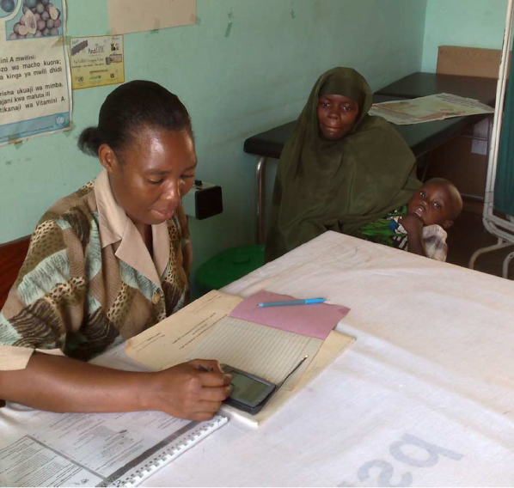
Tanzania e-IMCI Study
Implement IMCI on a PDA
Goal:
Demonstrate improved compliance to IMCI protocol
No increase in time of visits

Slide 16
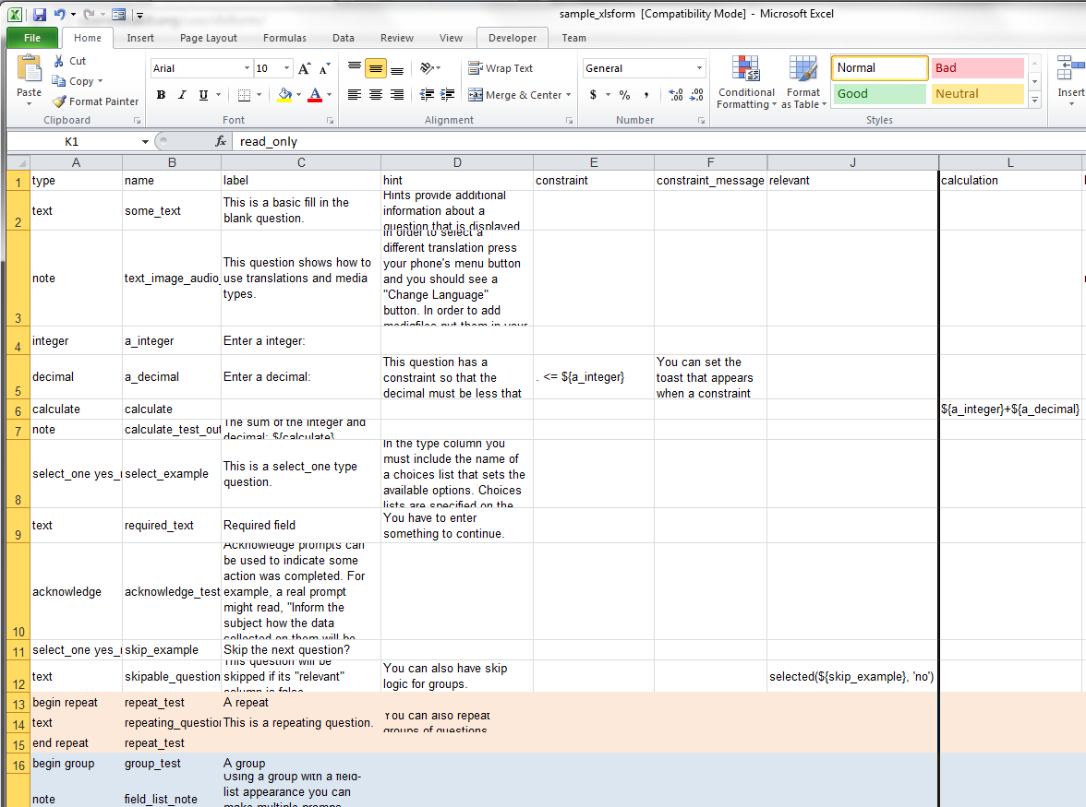
Open Data Kit 1.0
Collect
Forms based data collection application running on Android device
XLSForm
Form creation tool reading in Excel spreadsheet
Aggregate
Backend server to receive data

Slide 17
IMCI to ODK
Convert IMCI Protocol to decision tree
Encode in forms
Establish branching logic
Implement in spreadsheet
Compile to ODK
Challenges
Extracting the decision tree
Verification of wording and workflow
Usability
Medical review of IMCI
Difficulty in adapting protocol
Official approval of protocol
Determining correspondence of electronic and paper version

Slide 18
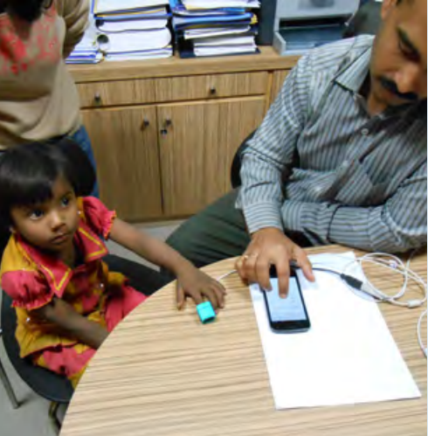
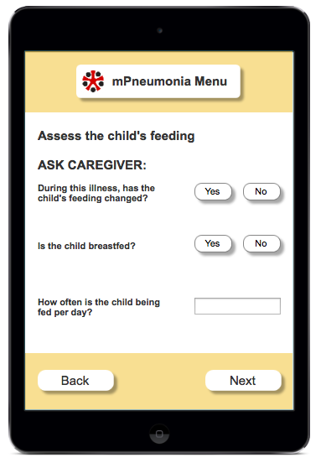
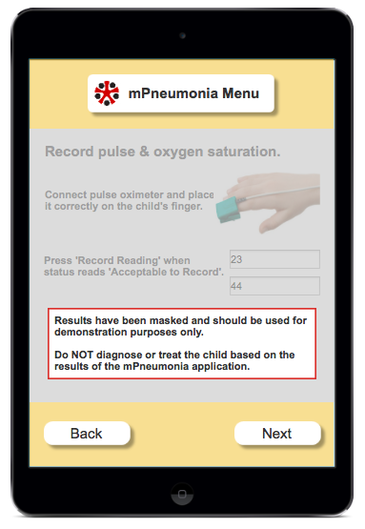
IMCI + Pulse Oximetry
Measure blood oxygen level
Low oxygen levels can indicate pneumonia
Add blood oxygen level into pneumonia questions
Pulse oximeter connected to mobile phone so readings entered automatically

Slide 19
Diagnostics
Issues
Cost of test
Precision of test
Accuracy of test
Error profile
Action on positive test
Action on negative test
Goals
Individual treatment
Public health goals
Positive Test
Negative Test
True Positive
False Negative
Have disease
False Positive
True Negative
Don’t have disease

Slide 20
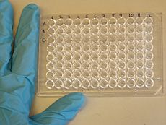
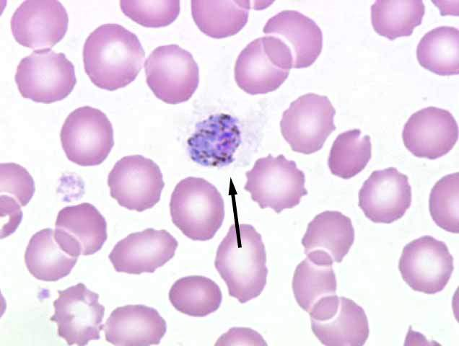
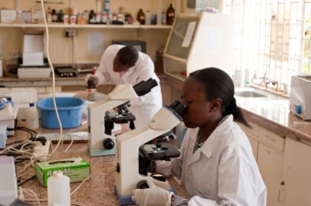
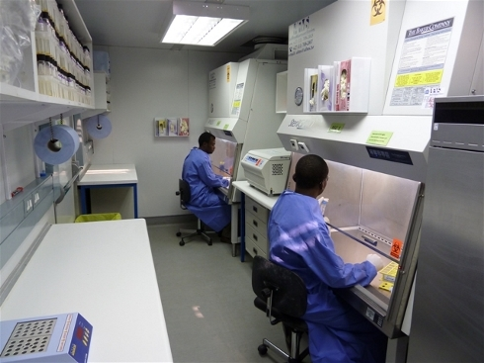
Lab Diagnostics
Highly accurate tests
E.g., Enzyme-linked immunosorbent assay (ELISA)
Microscopy
Requires infrastructure, trained staff, equipment
Issues
Costs
Transport of samples
Delays in processing or notification

Slide 21
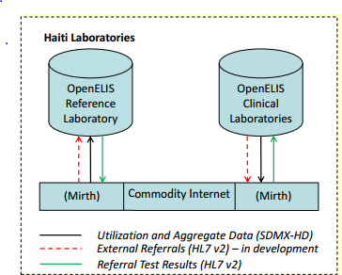
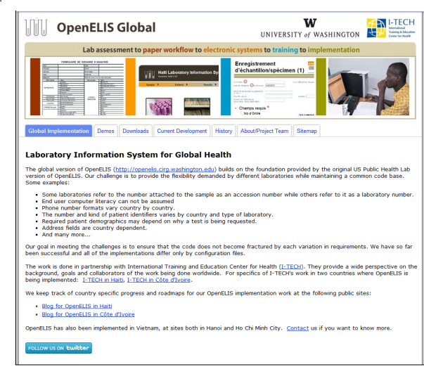
Lab Information System
Internal lab management
Tracking of samples and tests
Interoperability with medical records
Notifications
Probably not much difference between developed and developing world

Slide 22
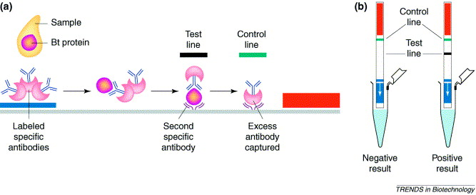
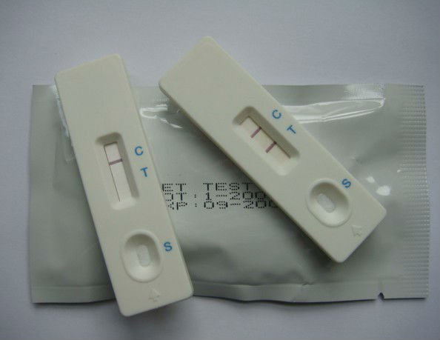
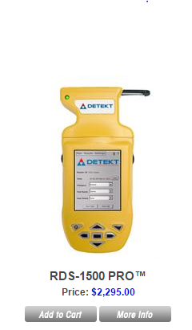
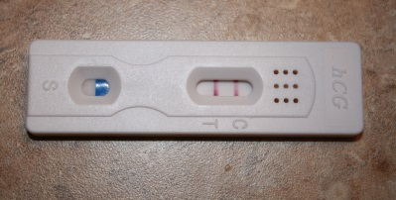
Rapid Diagnostic Tests
Point of Care Tests
Deliver results without sending test to lab
Fast turn around
Limited test preparation
Lateral flow immunochromatographic assays
Large number of tests available
Blood, Urine
HIV, Malaria, Syphilis

Slide 23
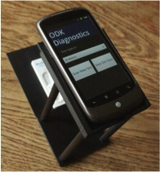
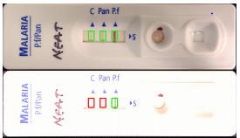
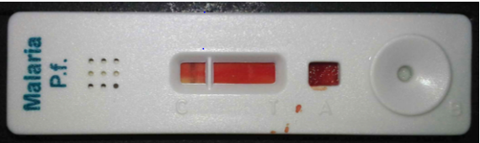
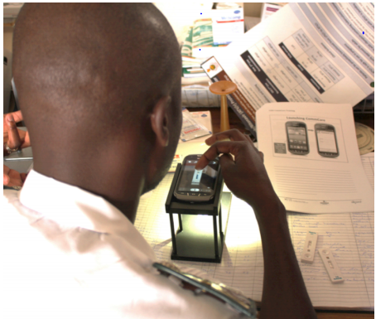
ODK Diagnostics
Nicki Dell, Gaetano Borriello
Image analysis on SmartPhone to read RDT
Computation done locally
Template to adapt to multiple tests
Use cases
Enable lesser trained health workers to conduct tests
Support tests which are not frequently used
Supervision
Quality control
Field trials
Zimbabwe

Slide 24
Gadgets

Slide 25
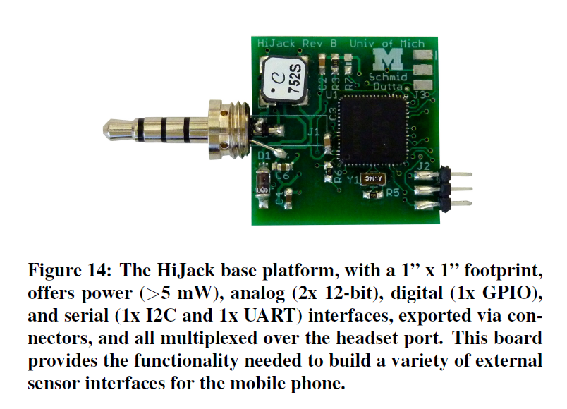
Hijack
Sensor interface through audio jack
EKG Interface
Soil temperature monitor
UBC Pulse Oximeter for iPhone
HIV Diagnostic

Slide 26
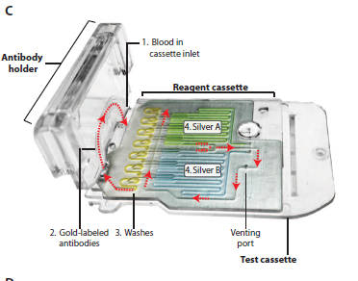
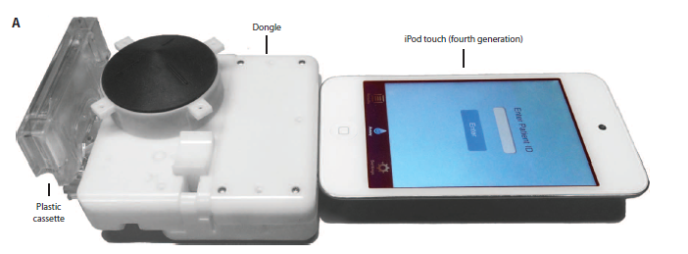
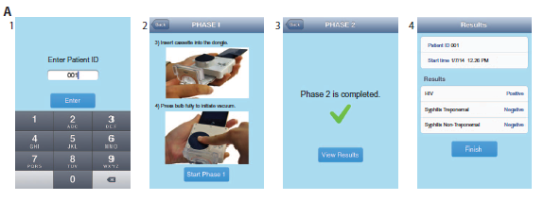
Smartphone for point of care diagnosis
Recent press attention on HIV/Syphilis diagnosis by Columbia University
Laboratory quality immunoassay
Ultra low power
Power from cell phone
iPhone = Battery
Signal processing on cell phone to generate results

Slide 27
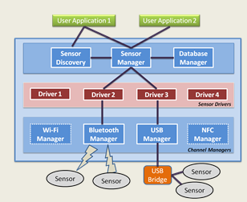
ODK Sensors
Build a user-level sensing framework with sensor drivers
No operating system modifications
Allows convenient reuse between applications
Create a single sensor interface
Access wired, wireless, and built-in sensors
Support multiple sensors over multiple channels
Focus on ease of deployment and development
Distribution through existing app store model
Reduce complexity
Without adverse effects on performance

Slide 28
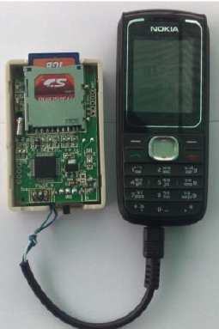
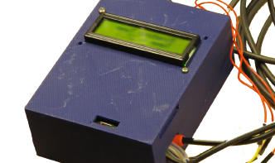
Fone Astra
Sensor connection to low cost phone
Phone for communication and output
$25 board + $25 phone
Temperature monitoring

Slide 29
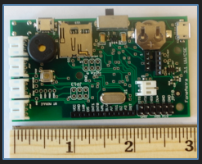
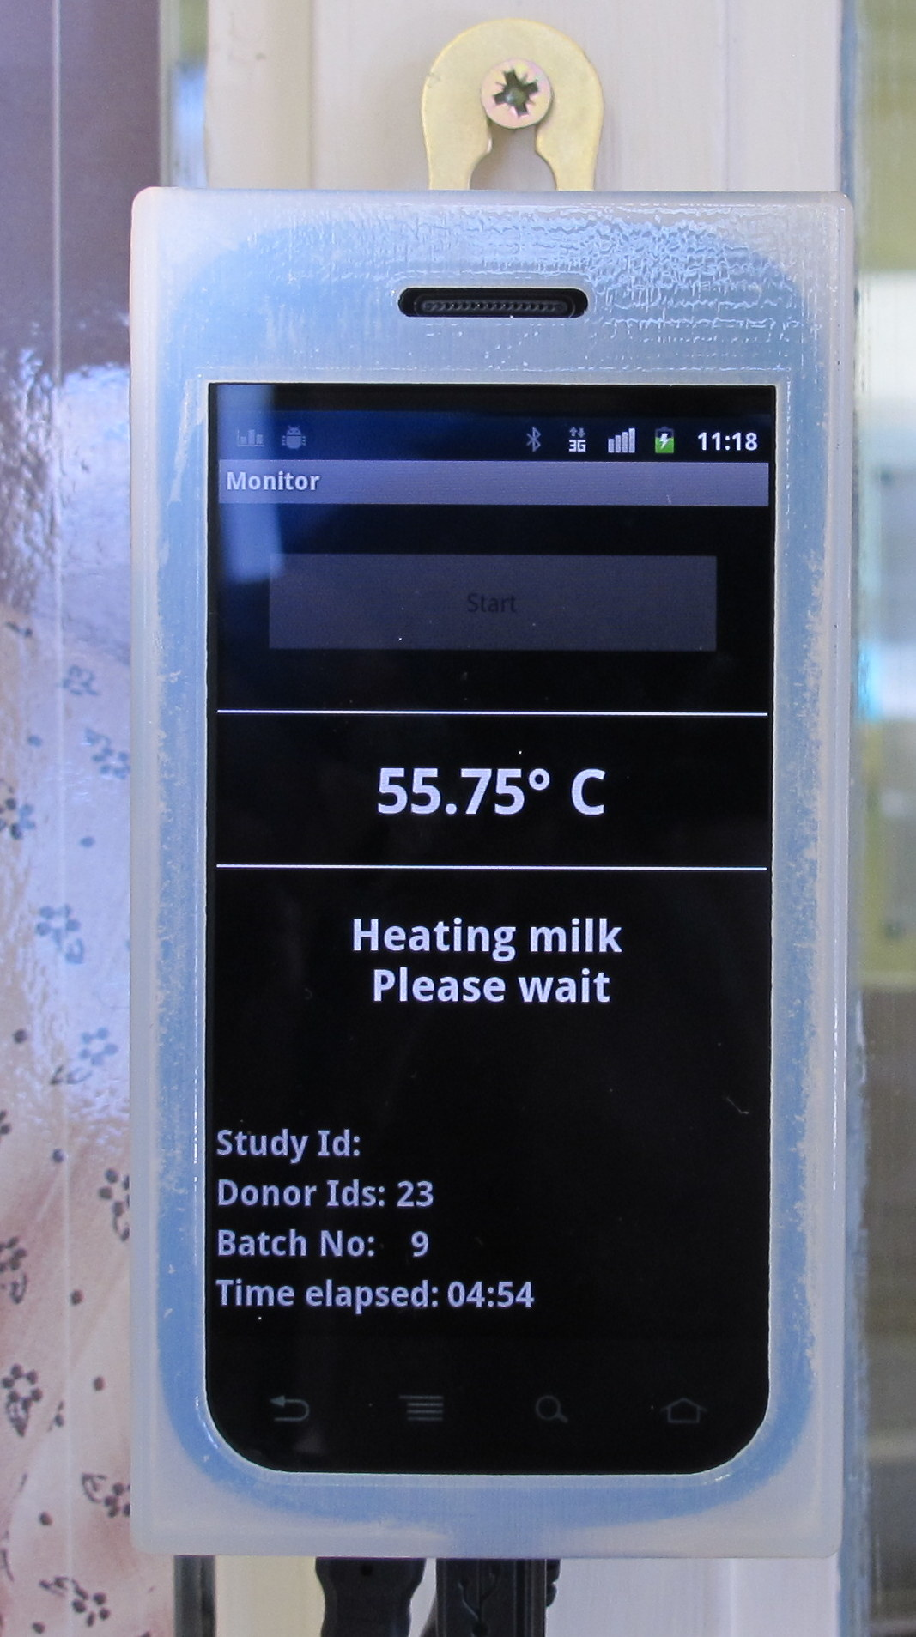
Android Fone Astra
Version 2 of FoneAstra replaced basic phone with Android phone
Communication by bluetooth or USB
Separate power for FoneAstra device
Programmability and UI on phone

Slide 30
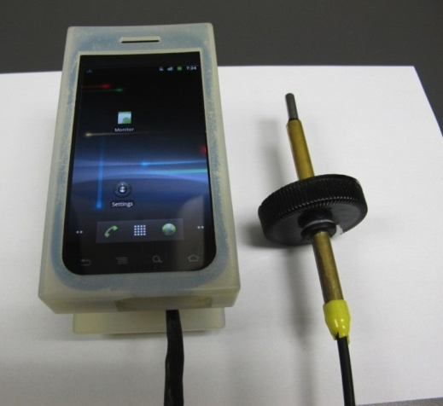
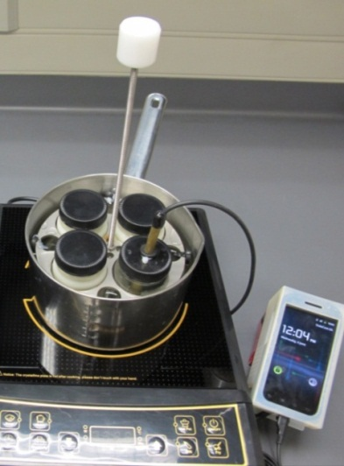
Milk Pasteurization
Human milk pasteurization
Replace high price pasteurizer with hotplate
Temperature monitoring to ensure proper heating and verify quality

Slide 31
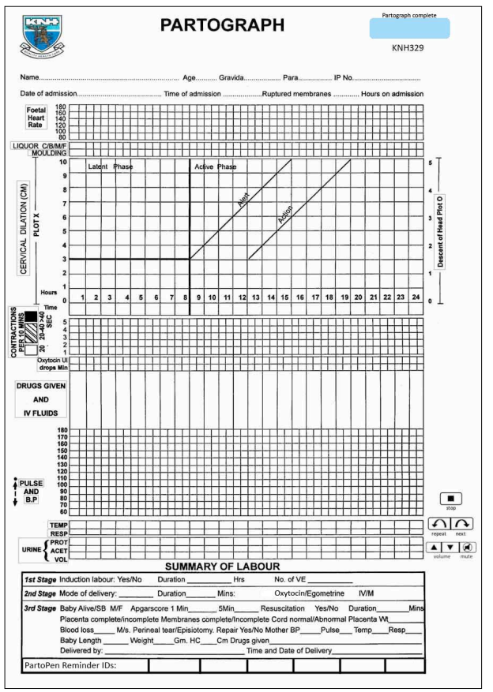
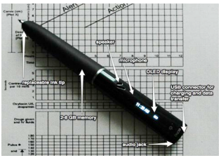
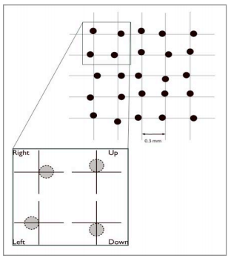
PartoPen
Paper record of birth progress
Plot dilation versus time
Too slow, issue an alert
Idea
Implement using a LiveScribe digital pen
Deployment
Nurses in Kenya, in both training and practice

Slide 32
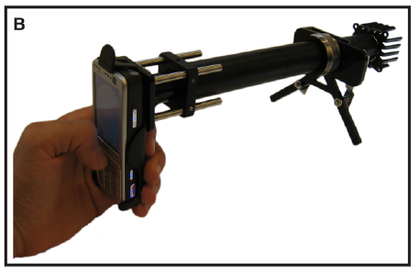
Cell Scope
UC Berkeley project
Dan Fletcher, Bioengineering
Build a cheaper microscope for diagnostics

Slide 33
Cold Trace
Remote temperature monitoring
Connection through audio port to Android phone
Deployments now rely on a single model of low cost Android phone
Well engineered product with substantial support
Need for multi sensor device

Slide 34
Next week
Supporting the health worker

